Slide 1
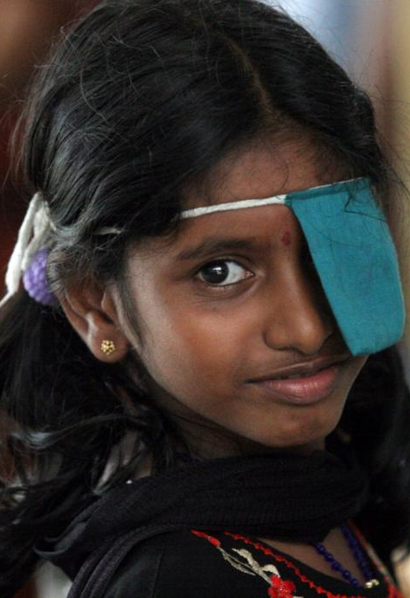

Aravind
Eye Care System
Current models / strategy / future vision / from 10 years ago till 2030
Dr.R.D.Ravindran

Slide 2
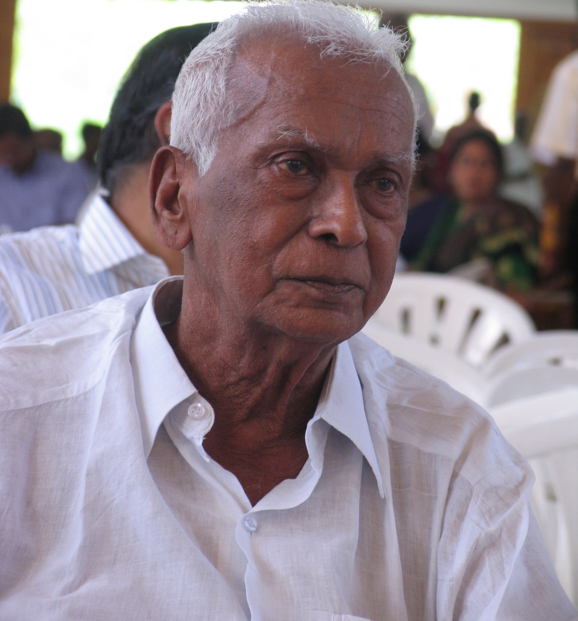
Vision of Dr. V
In a developing country with competing demands on limited resources, government alone cannot meet health needs of all the poor.
In a developing country with competing demands on limited resources, government alone cannot meet health needs of all the poor.
In 1976 …
Dr.Venkatasamy, feeling the urgent need, started an eye clinic with 11 beds, to create an alternate, sustainable eye care system to supplement government’s efforts

Slide 3
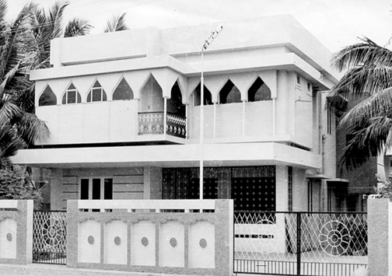
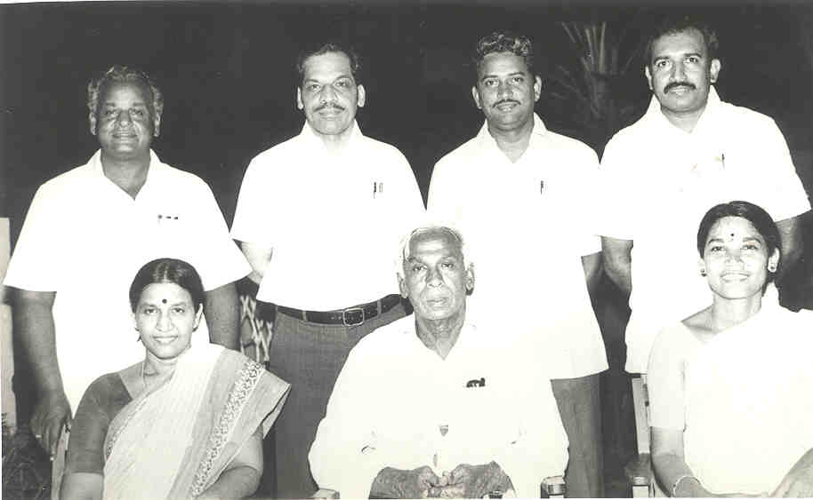
Humble Beginning of
Aravind Eye Care System
Aravind’s Vision:
To eliminate needless blindness by providing high quality, high volume,compassionate eye care to all
Notes:
3

Slide 4
Aravind’s Evolution 1978 - 2004
Setting up & developing hospitals Coming into existence Community outreach Focus on Cataract Services
Refining & Scaling up internally More Hospitals – TVL, CBE, PDY Establishing Aurolab & LAICO Education and Training
Notes:
4

Slide 5
Evolution of
Aravind Eye Care System
2004-2014

Slide 6

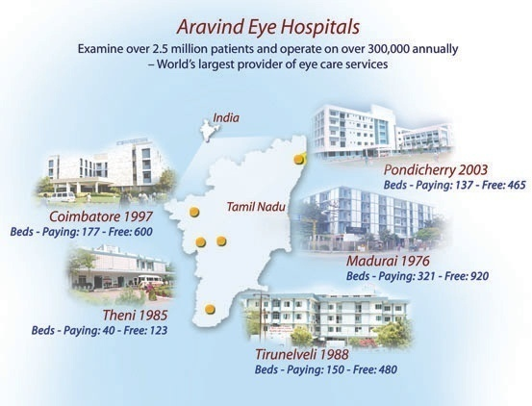
AECS in 2004

Slide 7
Performance in 2004
Category | 2004
Paying | 8,70,176
Free & Subsidized | 7,65,860
Total | 1,636,036
Category | 2004
Paying | 85,745
Free & Subsidized | 1,41,689
Total | 227,434

Slide 8
Reaching Out to the Non Customer

Slide 9
Uptake of Eye Care at
Outreach Camps
Study of uptake in eye camps
No of villages covered | 47
Population studied | 22,047
No of people with eye problem | 749
% of people with eye problem | 3.4%
Of the above, attended the eye camp | 51
% attending camp | 6.8%

Slide 10
Vision Centre
(Primary Eye Care)
Covers a population of 50,000
Staffed by Oph. Assistants
Active case finding at community level
Linked to Base Hospital
First center started in April, 2004
Notes:
10
10

Slide 11
Eye Care Without An Ophthalmologist
Notes:
Specialty referral 646; cataract referral – 339 (388 surgeries)

Slide 12
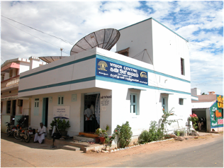
Comprehensive Primary Eye Care
Services Offered
Preliminary Examination
Refraction
Urine/Blood Test
Blood Pressure
Consultation with Ophthalmologist through Video – Telemedicine
Eye health education through Counseling
Glasses & Medicines dispensing services
Infrastructure
Refraction Cubicle
Slit Lamp
Computer, Web cam
Satellite Connectivity with Base Hospital
Optical dispensing unit
Autoclave
Generator
Staffing
1 Technician
1 Coordinator
1 Eye Health Field Worker

Slide 13
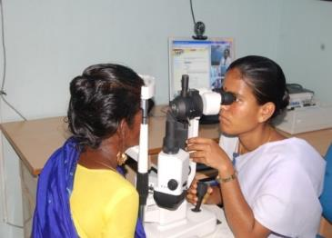
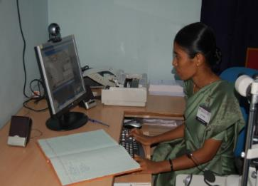
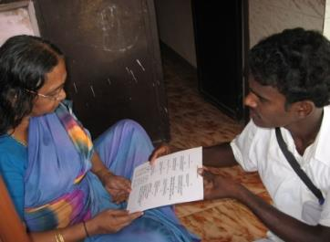
Staff mix and Responsibilities
Vision centre Technician:
dispense eye glasses
capacity to diagnose common eye problems,
able to handle slit lamp and fundus photography
Facilitate video conf. with ophthalmologist using IT
Vision Centre Coordinator:
patient registration , flow management, counseling
optical & medicine sales, accounts, statistics, inventory
Interpersonal coordination (community ↔ hospital)
Follow up on referrals
Eye Health Field Worker:
Community mobilization (survey, key informant methods…)
Identify and referring curable and incurable blind people
Outreach initiatives in association with Outreach dept.
Communication & Coordination (community ↔ centre ↔ hospital)

Slide 14
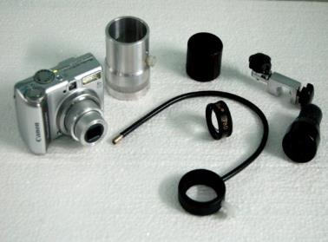
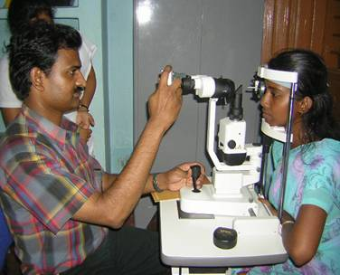
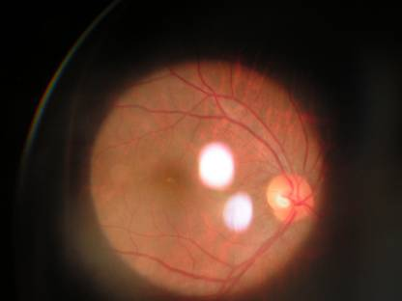
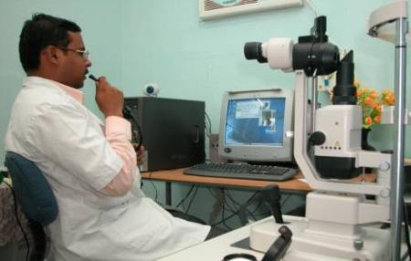

Innovation: Low cost technology for imaging
helps in video conference with Ophthalmologist…
Investment Cost:
Digital Camera & Adapter: US$ 250
vs.
Digital Fundus Camera: US$ 25,000
Only 15% of outpatients need to visit base hospital
Notes:
14

Slide 15
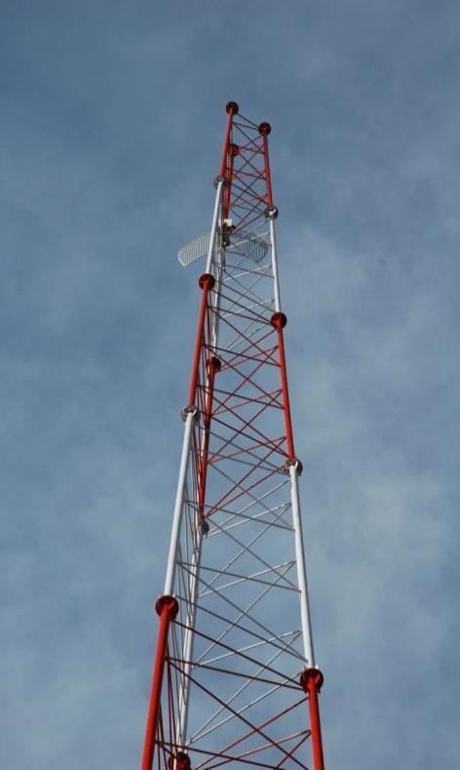
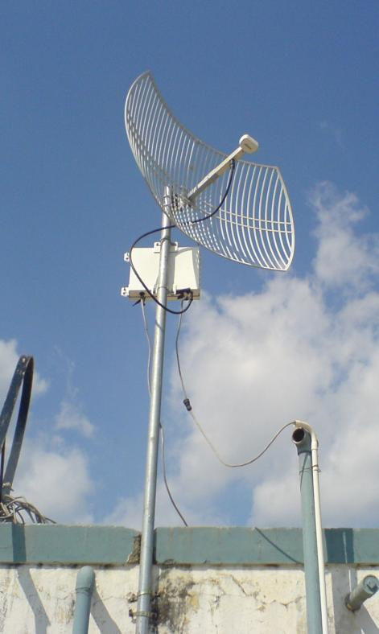
Technology for Connectivity
WiFi 802.11b
Low cost
Unidirectional antenna
Line of Sight:
Up to 40 miles
  DSL Connectivity
  (256 kbps to 2 mbps)
  (Broad Band with 4mbps)

Slide 16
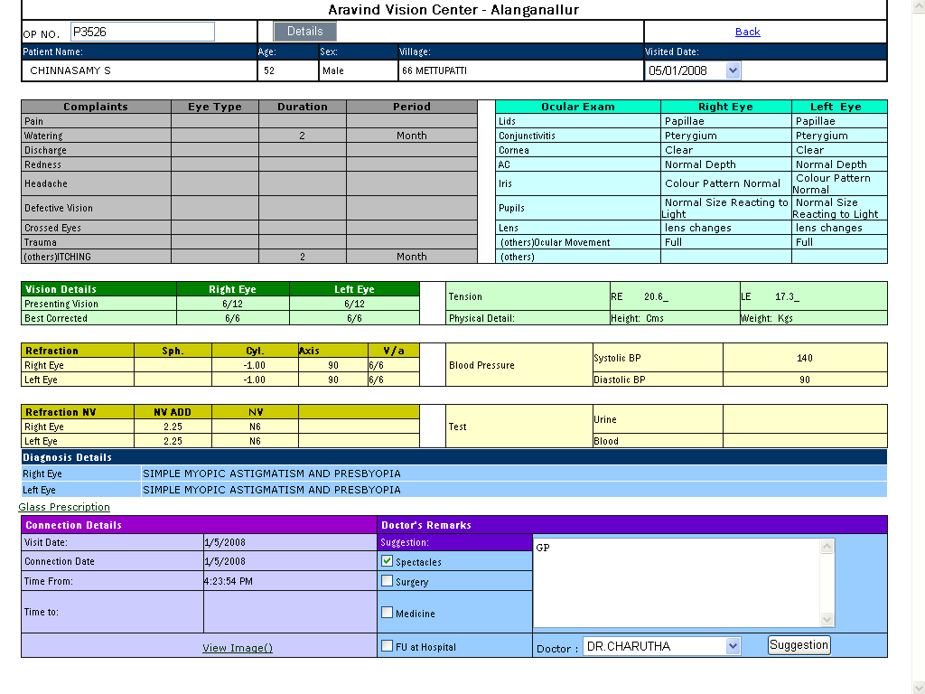
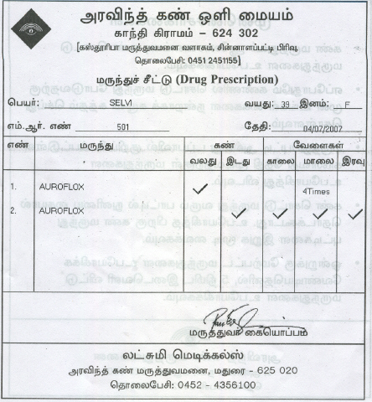
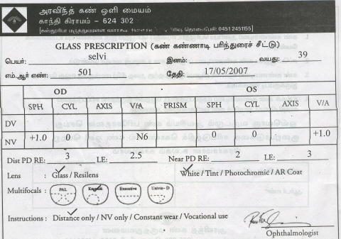
Electronic Medical Records in VCs

Slide 17
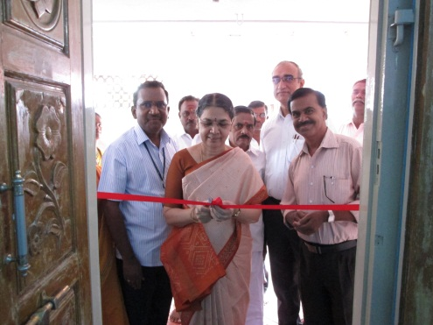
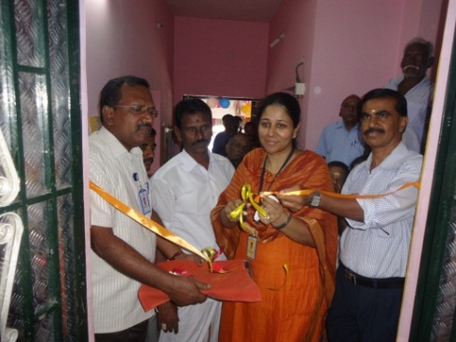
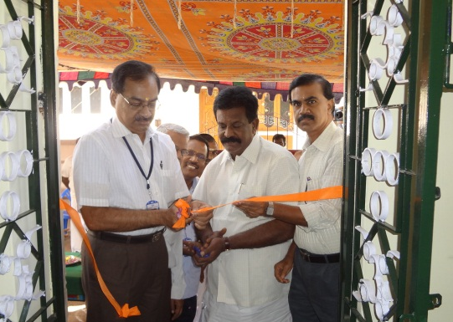
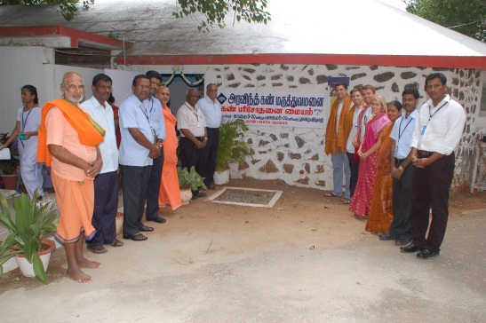
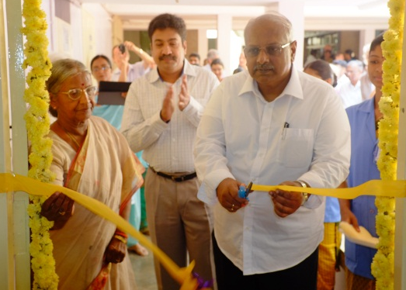
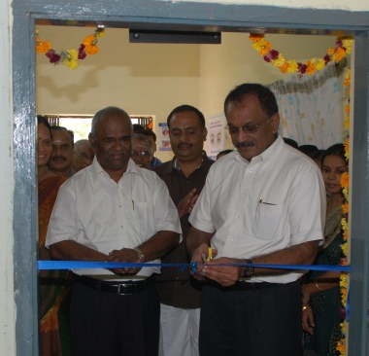
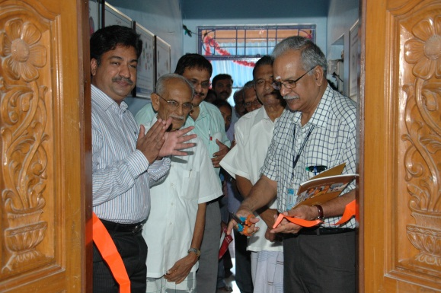
New Vision Centres - 2014
Vadamadurai
Thiruchuli
Oddanchatram
Patthamadai
Auroville
Kadayam
Parangipettai
Total Vision Centers – 49
Covering 3.5 million population and treating 330,000 patients Annually

Slide 18
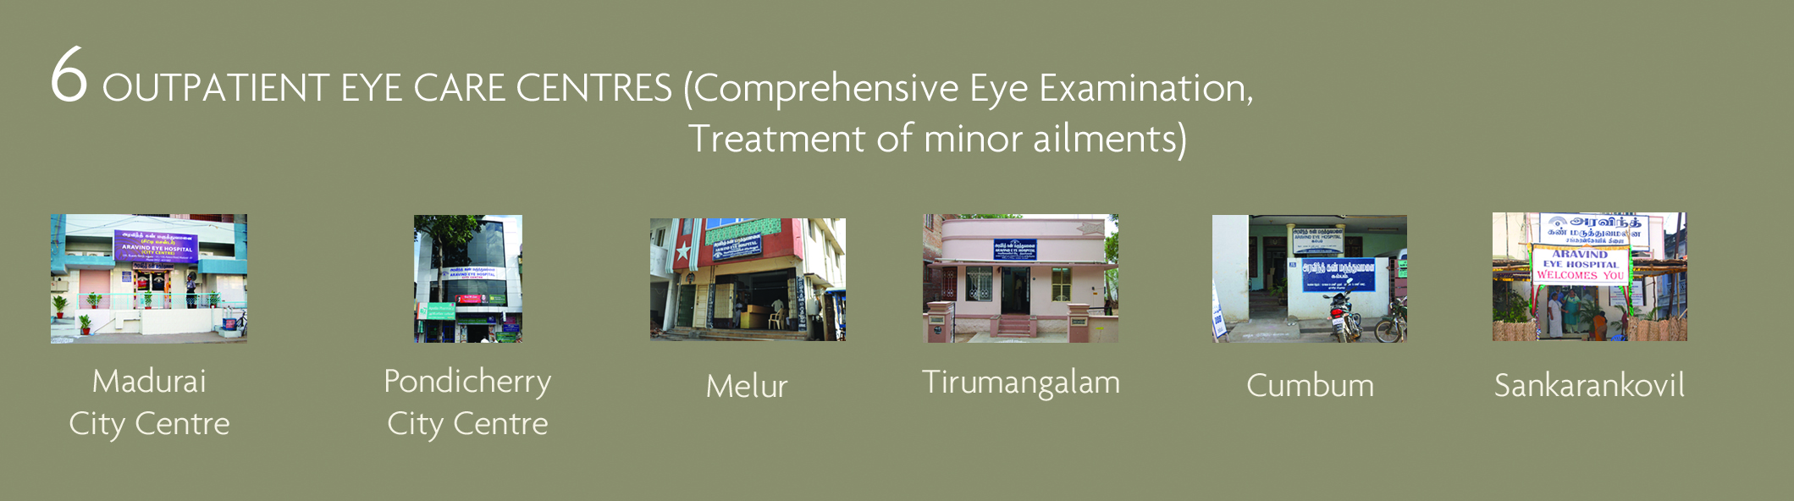
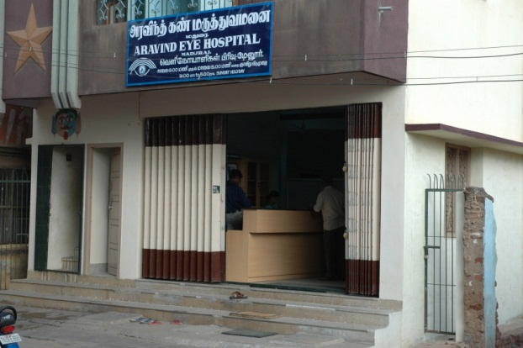
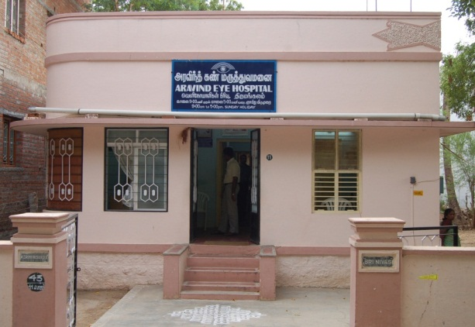
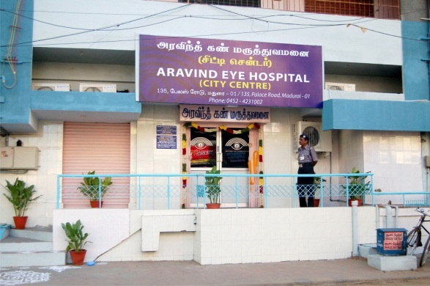
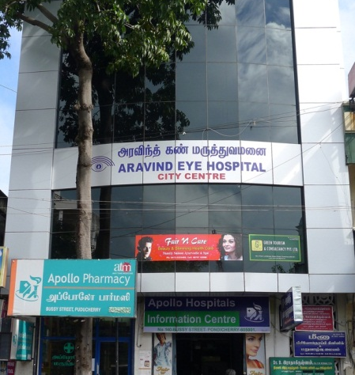
Reaching out to the Community
Community Eye Clinics
Sankarankoil- 1992
Melur -2004
Thirumangalam -2005
Madurai City Center
2009
Cumbum- 2008
Pondy City Center
2011

Slide 19
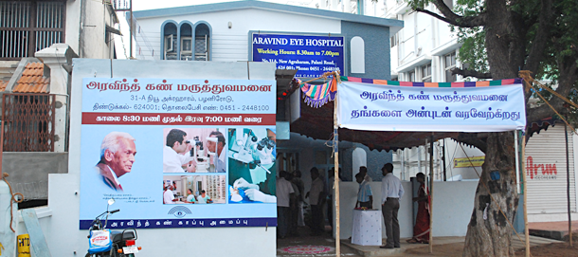
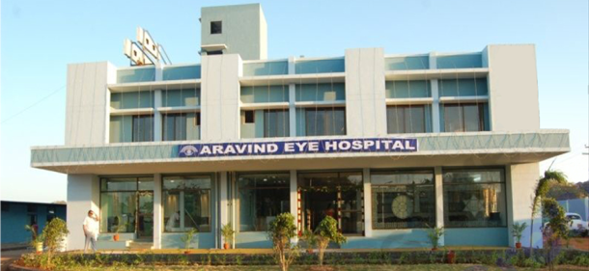
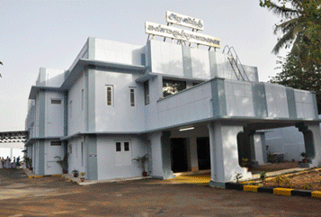
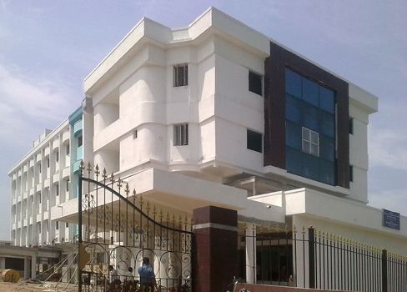
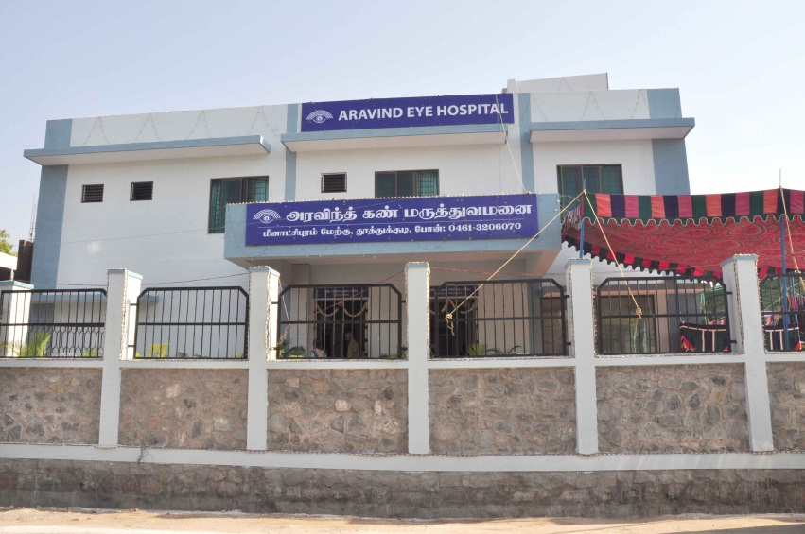
Tertiary & Secondary Hospitals
AEH Dindigul-2010
AEH Tirupur-2010
AEH Udumalpet- 2012
AEH Salem-2011
AEH Tuticorin-2012

Slide 20
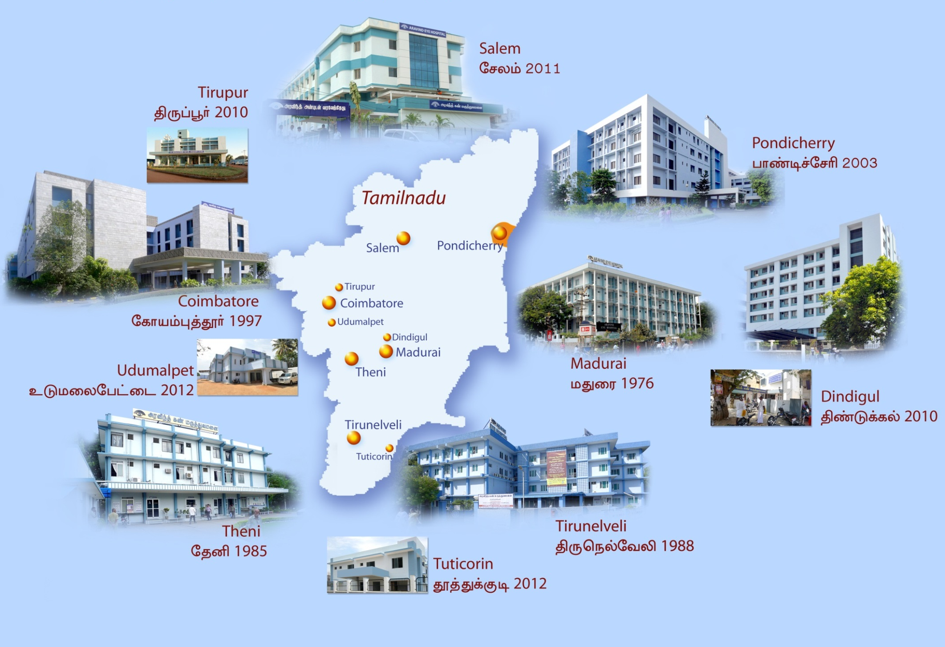
AECS in 2014

Slide 21




5
Specialty Care
Research
Training
Tertiary
Care Centers
1000 - 2000 patients
2014
5
A Day at Aravind
10,000 Patient Examinations
1,500 Surgeries
5-6 Outreach camps
  1,500 examined
  300 transported to base for surgery
Classes for 100 Residents & 300 technicians and administrators
Cataract Services Specialty Diagnosis
Secondary
Care Centers
150 - 400 patients
6
Comprehensive Eye Examination Treatment of Minor ailments
+
Outpatient
100 -150 patients
Centers
49
+
Comprehensive Eye Examination
Primary Care
15 -25 patients
Centers

Slide 22
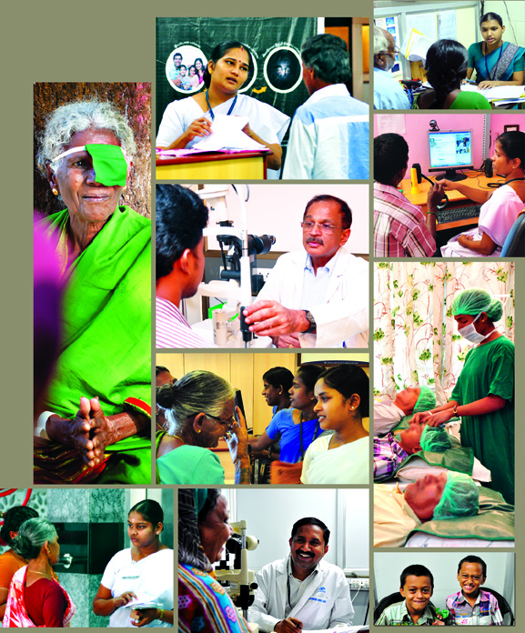
Human Resources
Category of Staff | 2004 | 2014
Doctors | 100 | 180
Fellows and Residents | 131 | 276
Paramedical & Support | 963 | 2667
Admin & Support Services | 444 | 484
Total | 1638 | 3607*
* Excluding Aurolab staff-530 & temporary Staff

Slide 23
Volume of Work 2013 – 2014
Total Out-Patient Visits – 32,75,179

Slide 24
Total Surgeries in the year 2014 – 3,78,035

Slide 25
Performance
2004 & 2014
Category | Outpatients
 | 2004 | 2014
Paying | 8,70,176 | 17,81,062
Free/Subsidized | 7,65,860 | 14,94,117
Total | 16,36,036 | 32,75,179
Category | Surgeries
 | 2004 | 2014
Paying | 85,745 | 1,90,192
Free/Subsidized | 1,41,689 | 1,87,843
Total | 2,27,434 | 3,78,035

Slide 26
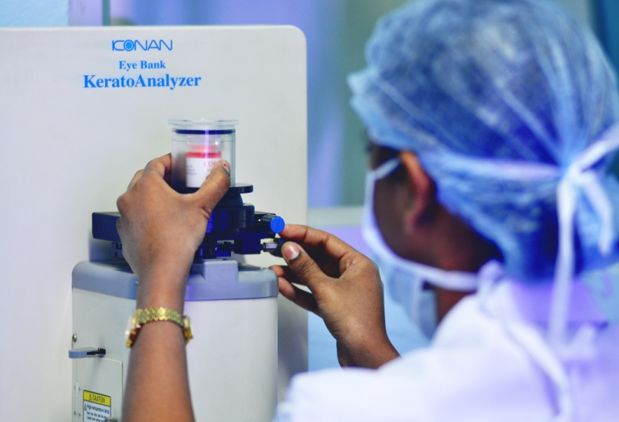
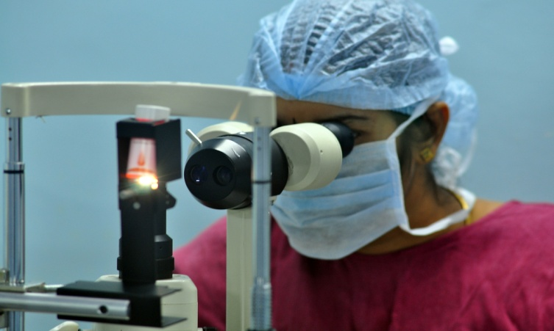
Eye Bank Statistics - 2013 to 2014
AEH | Eyes Collected | Utilised for Surgery
Madurai | 1606 | 911
Coimbatore | 1687 | 690
Pondicherry | 921 | 290
Tirunelveli | 575 | 327
Total | 4,789 | 2,218

Slide 27
Comprehensive Performance Monitoring
Set of standard indicators developed by each department covering 5 Dimensions
    Quality of Documentation
    Quality and Quantity of services
    Human Resources
    Academic and Training activities
    Department Administration
Both clinical &non-clinical departments

Slide 28
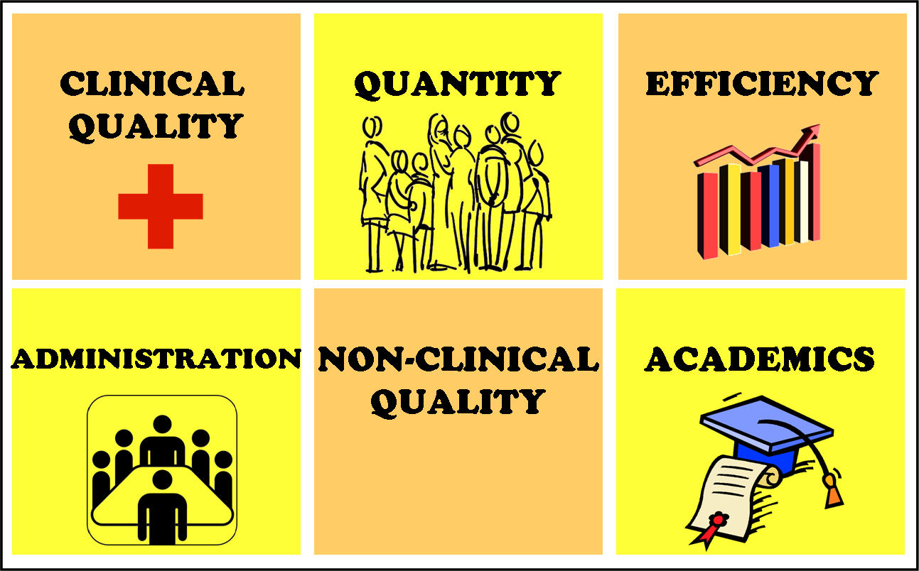

What do we Measure?
What do we Measure?

Slide 29
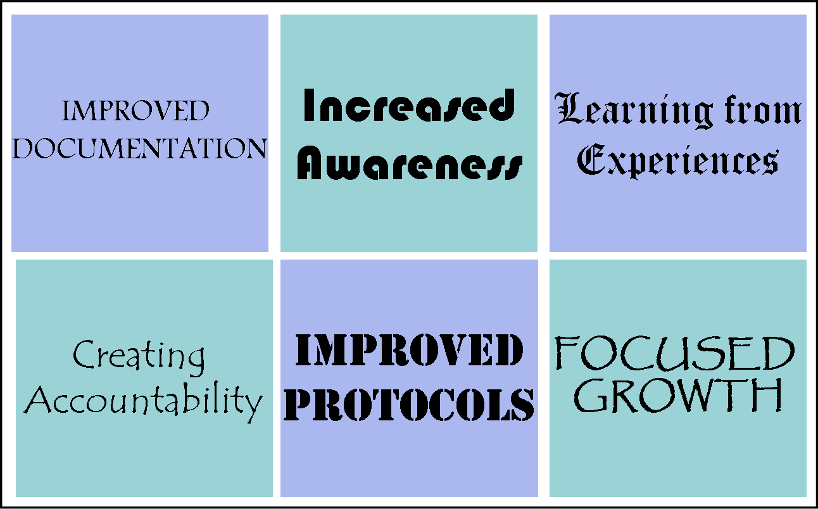
Impact of Comprehensive Performance Monitoring System
Improved Quality
of
Case Records
Organization wide awareness about performance
Family Glaucoma Screening Initiative
Optical Shop Glass Prescriptions
Use of Flourescien strips in the Glaucoma Clinic
Fixed targets and action plans for areas needing improvement

Slide 30
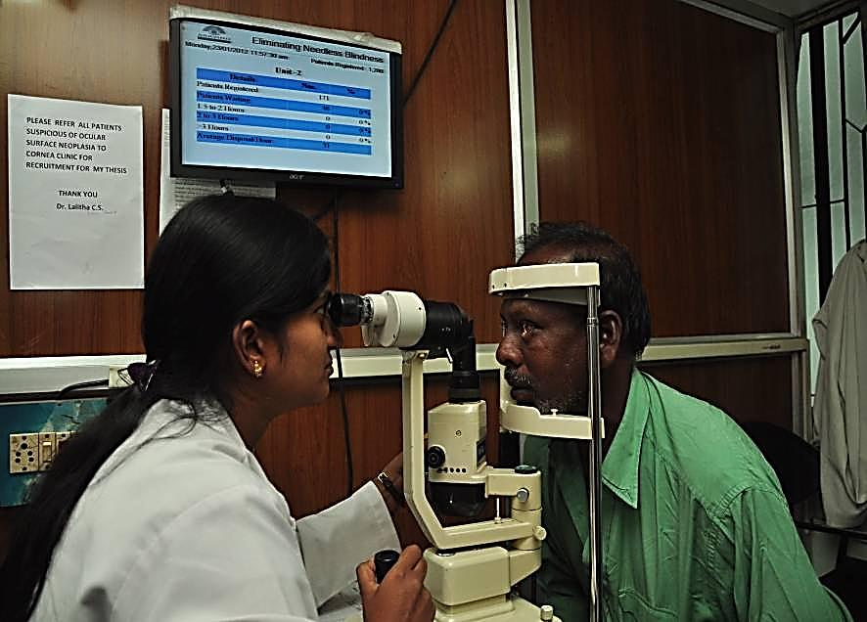
Patient waiting Data

Slide 31
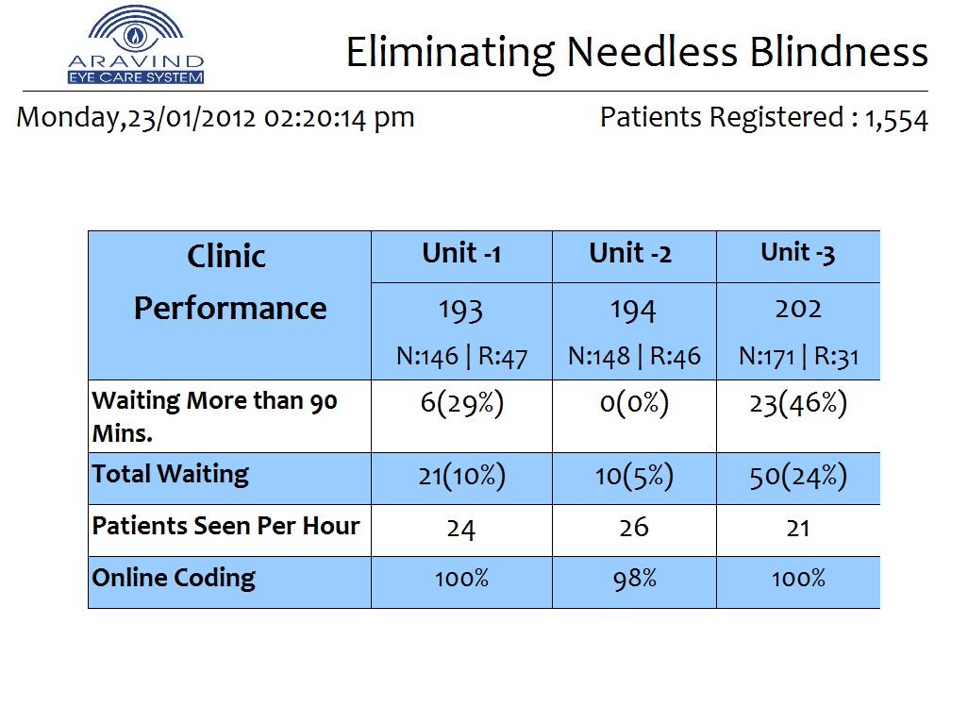

Slide 32
Recent Initiatives

Slide 33
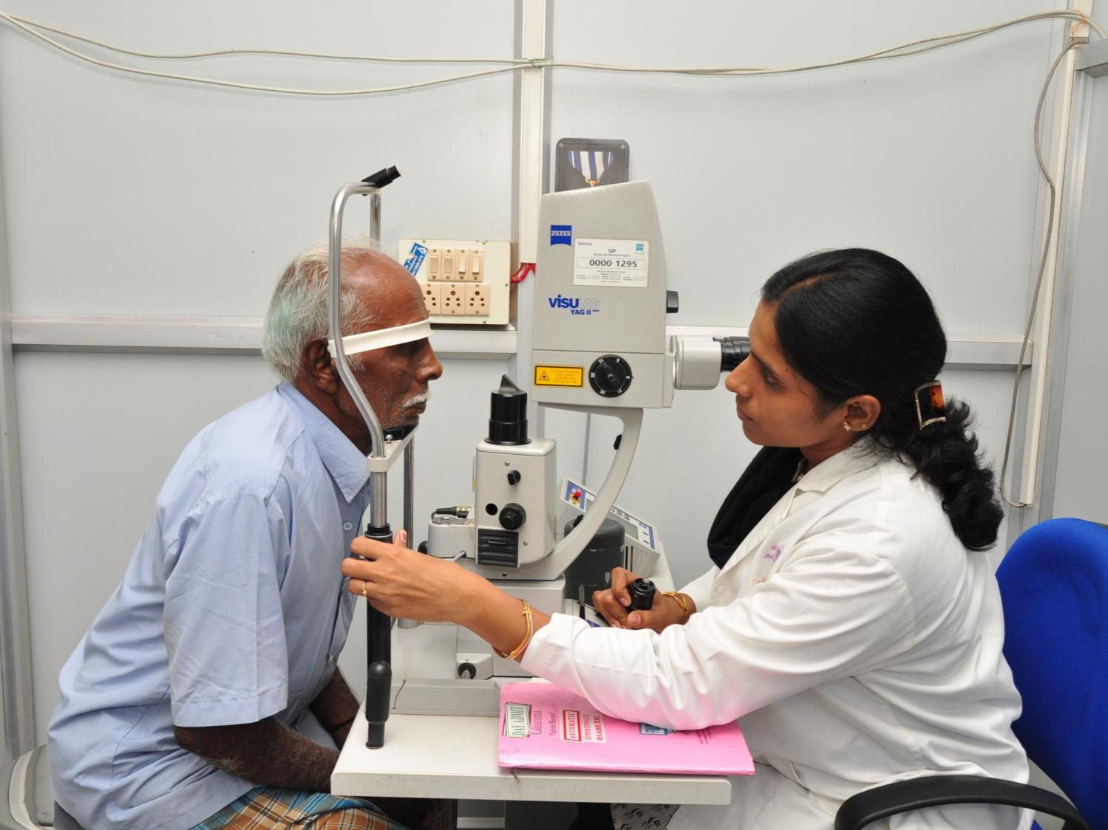
Patient Care: Quality
Quality standards adopted across all Aravind hospitals by 2014
Cat QA implemented in all centres
Improved patient compliance
Improved patient satisfaction

Slide 34
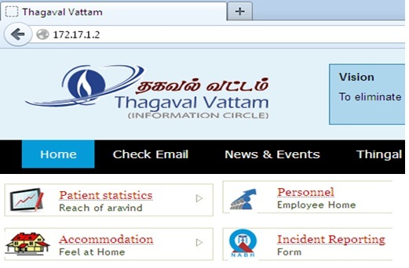

172.17.1.2

Slide 35
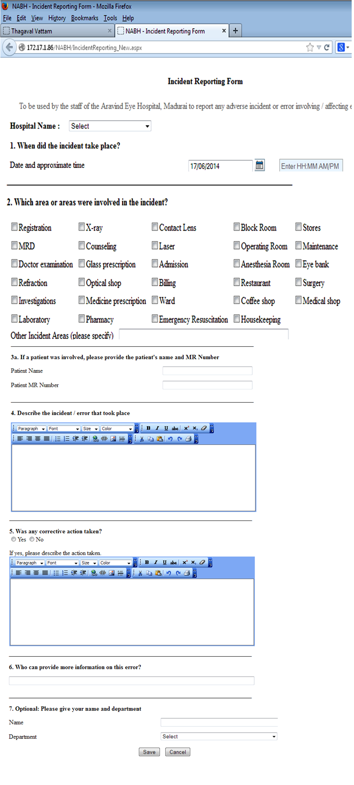

Slide 36
Patient volume Vs reported incidents
Madurai - 2013
Volume vs Incidents | Jan – Dec 2013
Outpatients | 994,197
Surgeries & Lasers | 146,582
Incidents reported | 583 (0.06%)

Slide 37
Correct patient, eye, procedure
Correct implant power, design, drug
Prevent mortality & morbidity due to systemic emergencies
Reduction of post-op infections
Eliminate sight threatening complications
1
Redefined
Patient Safety Goals
2014
2
3
4
5

Slide 38
Eliminate medical / diagnostic errors
Ensuring correct medication
Ensuring correct spectacles
Ensuring physical safety
Follow-up of High Risk Ophthalmic Patients
6
7
8
9
10

Slide 39
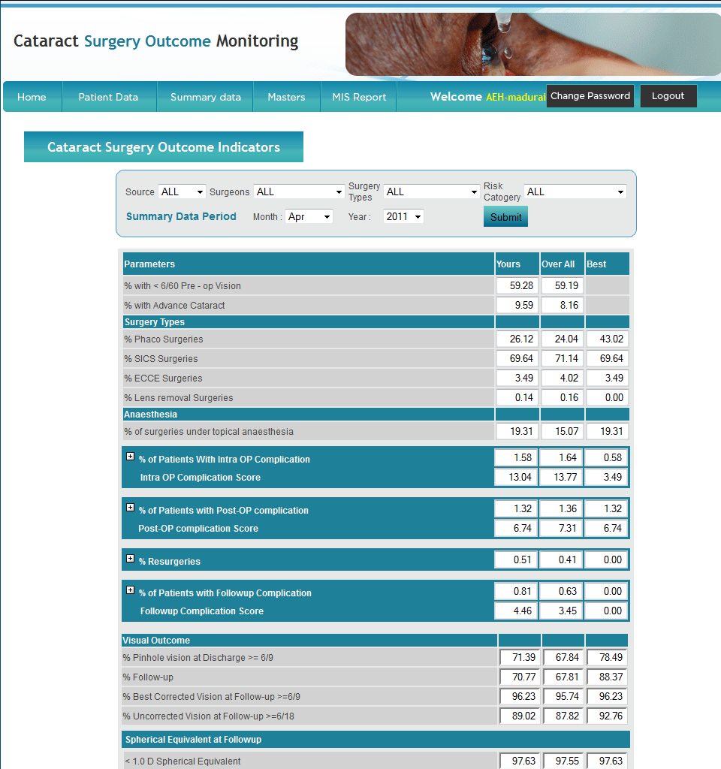
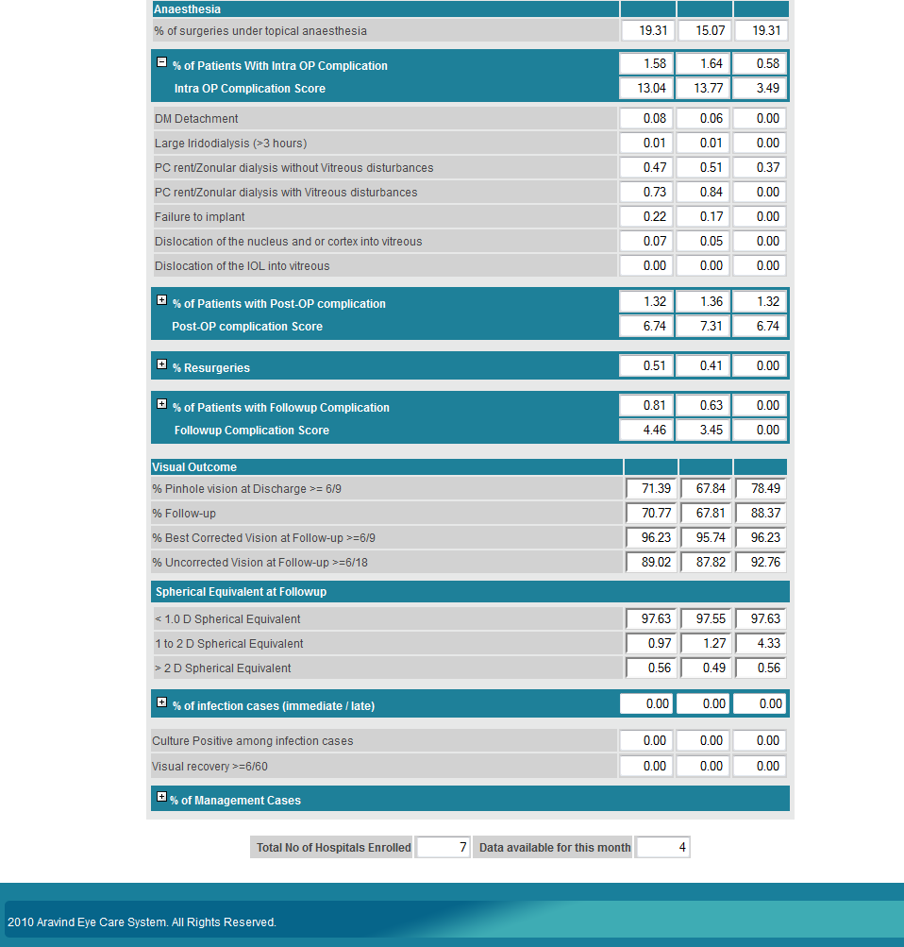

Slide 40
Patient Focus Group Discussions
To understand patient expectations
Facilitated discussion
Clinicians & Nurses observe & interact with patients
Audio recorded for sharing & teaching

Slide 41
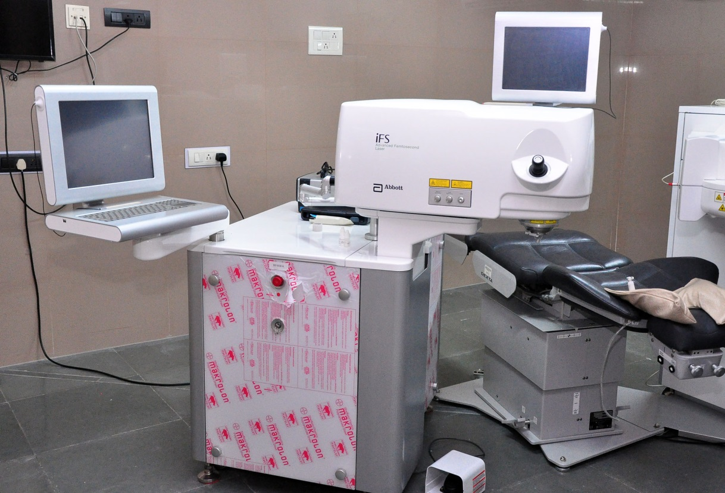
Technology upgradation
2004-2014
Refractive Surgeries
  Addition of Femtosecond Laser
Femto Second Laser

Slide 42
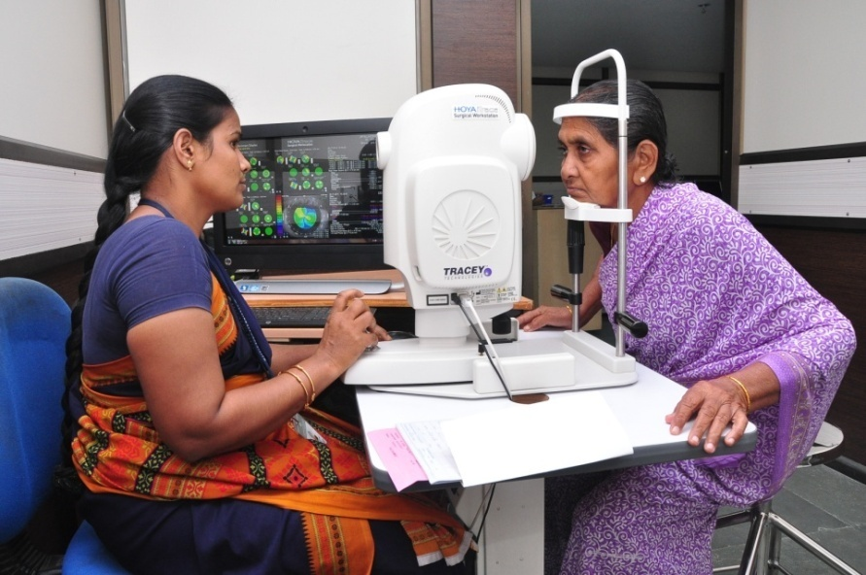

Technology upgradation
2004-2014
Hoya iTrace surgical workstation
Centurion system for Phacoemulsification
Femto-laser for cataract surgery

Slide 43

New Services
Ocular genetic counselling service
Establishing centres for excellence in genetics for retinoblastoma

Slide 44

Electronic Medical Record

Slide 45


EMR in Madurai City centre

Slide 46

Aspirations
ARAVIND EYE CARE SYSTEM

Slide 47

Making eye care affordable...

Slide 48

Patient Care 2O2O:
1 million surgeries per year

Slide 49
Factors – contributing to increase in surgeries
Aging population
Higher prevalence of blindness
Churning of the market by competition
Financial inclusion: Insurance
Improve Coverage of Specialty eye conditions
Increase in number of VCs
New Hospitals

Slide 50
India’s growing elderly
8% (~100 million) people in India are 60+ years old
Country | % Pop 60+
Japan | 25%
US | 17%
Australia | 15%
China | 12%

Slide 51
Tamil Nadu:( Service Area)
Population – Age distribution
 | TN | 2011 | 2016 | 2021 | 2026
 |  | In Millions
 | Population | 67.4 | 69.3 | 70.8 | 71.8
Age group | 0 -14 | 23% | 21% | 20% | 19%
 | 15 – 49 | 56% | 54% | 53% | 51%
 | 50-60 | 10% | 11% | 12% | 13%
 | 60+ | 11% | 13% | 15% | 17%
50 + population will increase
by 4 Million

Slide 52
Blindness Categories based on Presenting Vision in 50+ Population
Blind in one or both eyes: 16.2%
Low vision: 21.3%
UB
SB
8.9%
2.8%
EB
4.4%
LV
21.3%
NN
62.5%
2007 survey of 50 + population
Rapid Assessment of Avoidable Blindness
TamilNadu

Slide 53
Blindness based on Presenting Vision in 50+ Population
(In year 2011)
Tamilnadu Population; 67.4 Million
50 + Population: 21.6%; 14.6 Million
2.36 Million blind in one or both eyes
3.39 Million with low vision
Approximately 2/3rd of them need surgical care.

Slide 54
Medical Insurance
Volume handled in a month
  1400-1500 Surgeries
  500 OP Procedures or Investigations
Constitutes
  16.83% of annual Surgical revenue
  5-6% of Total number of surgeries performed
Currently we have enrolled
  6 Insurance companies & 12 TPAs
  13 Central Government Institutions
  9 State Government Institutions
  15 Corporates

Slide 55

Growth in Specialty Surgeries
Specialty conditions remain grossly underserved
We will adopt a proactive approach to address specialty eye conditions

Slide 56
Eye Camps in the year 2014: 2609
Total OP seen – 5,58,155
Types of camps | No
Comprehensive Eye Camps | 1,507
Diabetic Retinopathy Camps | 446
Work place Camps | 234
School Children Screening camps | 269
Paediatric Eye Camp | 121
Mobile Van Refraction Camps | 32
TOTAL | 2,609

Slide 57
Community Outreach For Speciality Services
Mobile van with Retcam and Technicians for ROP screening in rural areas
Screening of diabetic patients in physician clinics
  From 5 clinics to 100 clinics
  Cover about 100,000 diabetics annually

Slide 58
Uptake Comparison
Eye camps vs. Vision Centres
 | Camp “Study” | 48 Vision Centres*
No of villages covered | 47 | 2,380
Population studied/covered | 22,047 | 3.1 Million
No of people with eye problem | 749 | 625,000
% of people with eye problem | 3.4% | 20%
Attended eye camp/V. Centre | 51 | 692,980
% sought care | 6.8% | >100%
% of the population | 0.23% | 22.19%
* From inception till end July 2014

Slide 59
Vision Centre Expansion
Planning for 100 more centers covering a population of 6 Million over the next 10 years
Notes:
59
59

Slide 60


Current Hospital locations

Slide 61

Current & Proposed Locations
c
c
c
c
Salem

Slide 62
Surgeries
Historic annual growth Rate over last 8 years:
605,000 surgeries

Slide 63
Surgeries
Projected annual growth over next 8 years:
850,000 surgeries

Slide 64
Patient Care 2O2O:
1 million surgeries per year
Projected growth : 850,000
New Hospitals : 100,000
150 Vision Centers : 50,000

Slide 65
A final example is a five-forward / five-backward analysis* that can be used to analyze growth
Surgeries (Thousands) and Percent Annual Growth
EXAMPLE
Year | Madurai |  | Theni |  | Tirunelveli |  | Coimbatore |  | Pondicherry |  | New Hospitals |  | Total
2006 | 107 | 3% | 9 | -8% | 38 | 2% | 65 | 3% | 33 | 1% |  |  | 252 | 2%
2007 | 107 | 0% | 10 | 7% | 39 | 4% | 69 | 7% | 37 | 12% |  |  | 263 | 4%
2008 | 112 | 4% | 9 | -8% | 40 | 2% | 73 | 5% | 36 | -2% |  |  | 270 | 3%
2009 | 119 | 7% | 11 | 15% | 41 | 3% | 74 | 2% | 41 | 14% |  |  | 286 | 6%
2010 | 129 | 8% | 11 | 6% | 47 | 13% | 78 | 6% | 43 | 6% | 2 |  | 310 | 8%
2011 | 134 | 4% | 12 | 2% | 49 | 5% | 82 | 4% | 46 | 6% | 4 | 120% | 326 | 5%
2012 | 140 | 4% | 12 | 2% | 51 | 5% | 85 | 4% | 48 | 6% | 10 | 120% | 347 | 6%
2013 | 146 | 4% | 12 | 2% | 54 | 5% | 89 | 4% | 51 | 6% | 15 | 50% | 367 | 6%
2014 | 153 | 4% | 12 | 2% | 56 | 5% | 93 | 4% | 54 | 6% | 20 | 40% | 389 | 6%
2015 | 160 | 4% | 13 | 2% | 59 | 5% | 97 | 4% | 58 | 6% | 28 | 35% | 413 | 6%
2016 | 167 | 4% | 13 | 2% | 62 | 5% | 101 | 4% | 61 | 6% | 36 | 30% | 439 | 6%
Past
Future
A five-forward/ five-backward analysis will help AEH plan how much each hospital will contribute to each year’s growth
Example Analysis: These do not represent actual projections.
*A similar analysis is used to sustain growth at Emerson Electric.

Slide 66

Human Resource
Staff certification
Innovate for efficiency
Reinforcing values & culture

Slide 67

Research
Proactive mentoring of research
Support structure for research
Cross-fertilizing research ideas
Facilitating innovation

Slide 68



In 2O12:
2 million IOLs per year
IOLs, suture needles, blades, pharmaceuticals, equipment
2O2O:
Touching 10 million lives per year
New markets: Total solution provider
Beyond replication to innovation

Slide 69

Influencing eye care services worldwide…
Working with 300 eye hospitals worldwide…

Slide 70

Impact of consultancy, training & research…
2 million additional surgeries per year
2 million spectacles dispensed per year
Eye care: Universal Coverage for 1 billion
10 million diabetics covered
10,000 paramedics in training
Beyond cataract: viable service delivery

Slide 71
Leadership Development

Slide 72
Tertiary Centers
All Specialty Care
Research
Training
Complex organization
High Complexity
Secondary Centers
Cataract Services
Added more Specialty Services
Included many support facilities
Developmental phase
Surgical Centers
Outpatient Centers
Low
Complexity
Cataract Services Specialty Services
Initial phase
Primary Centers

Slide 73









Adherence to Values & Mission
Decision Making
Strategic planning & support
AMRF
CENTRAL LEADERSHIP
Formulating goals
Setting systems
Contribution to the larger mission
Managing HR
HOSPITAL LEADERSHIP
Innovations
Process improvements
Day to day operations
DEPARTMENT /OPERATIONAL LEADERSHIP
Day to day operations
GROUND STAFF

Slide 74
“Big projects are like mountains, which should be climbed with as little effort as possible and without urgency.
The reality of your own nature should determine your speed. If you become restless, speed up. If you become tense and high-strung, slow down.
You should climb the mountain in a state of equilibrium.
When each task of your project is not just a means to an end but a unique event in itself, then you are doing it well,“
- Dr. A.P.J Abdul Kalam

Slide 75

Thank You

