Slide 1
WAEH: Dreaming about 2030
Thursday
9th October 2014
Rob Elek
Director of Strategy &
Business Development

Slide 2
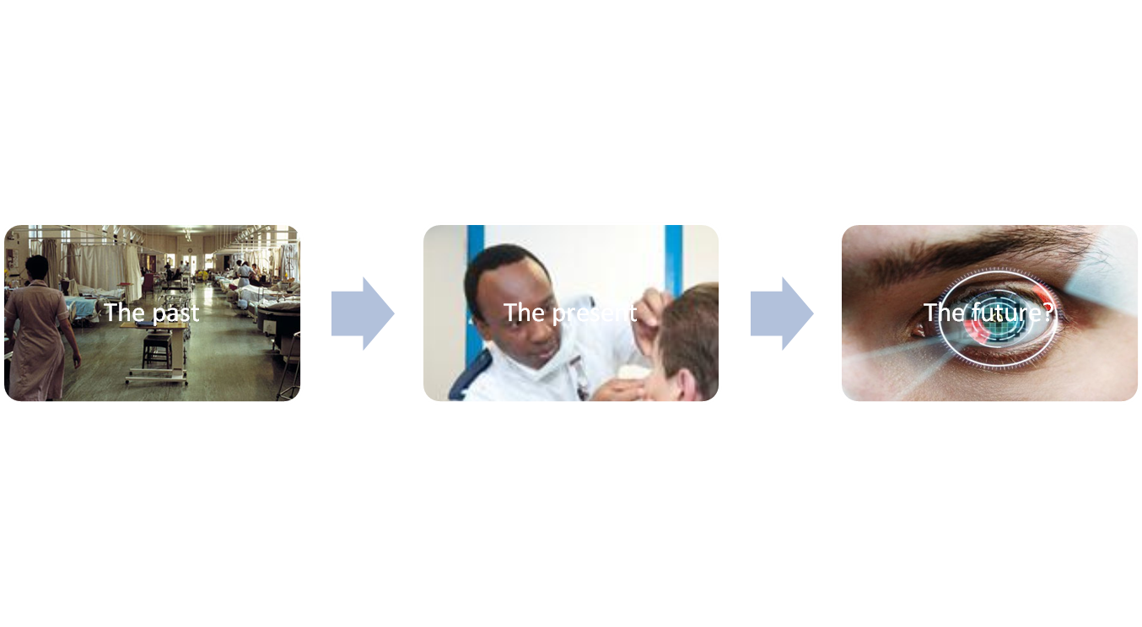
Evolution pathway – strategy and network

Slide 3
Where have we come from

Slide 4
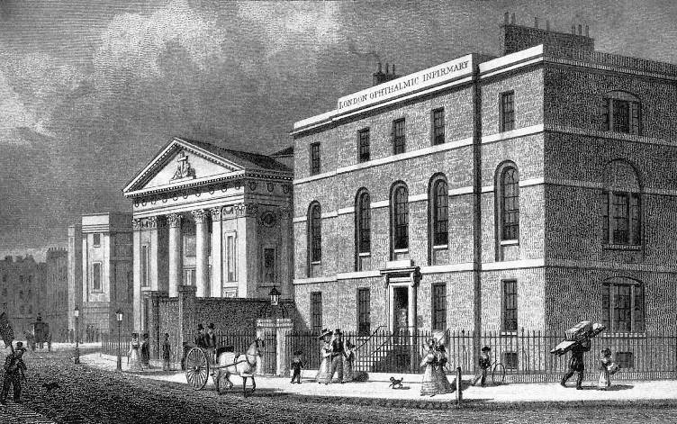
The London Ophthalmic Infirmary, 1822

Slide 5
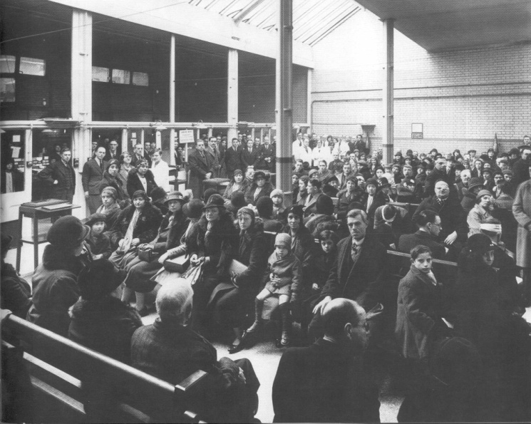
Patient Expectations

Slide 6
“Outreach” model
Central Site

Slide 7
How our strategy and network have evolved
Network:
Undifferentiated - lack of clarity about relationships between sites, perceived quality differences, communications
Clinical care:
Shift to daycase / phako surgery, imaging, no effective treatment for AMD

Slide 8
Where are we now

Slide 9
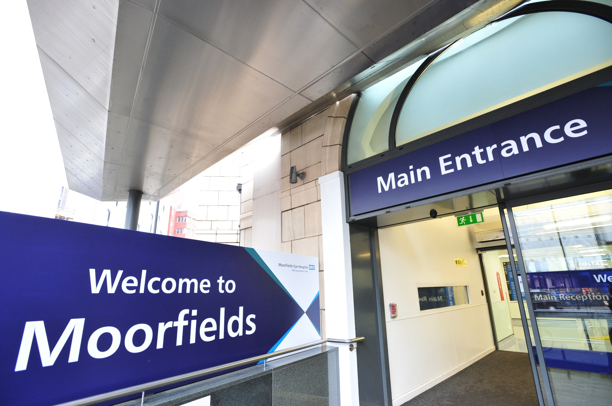

Slide 10
Moorfields strategy
To be the leading international centre in the care and treatment of eye disorders, driven by excellence in research and education

Slide 11
Network model
District Hub
E.g.
Ealing
Localities
Central Site
District Hub
Localities
District Hub

Slide 12
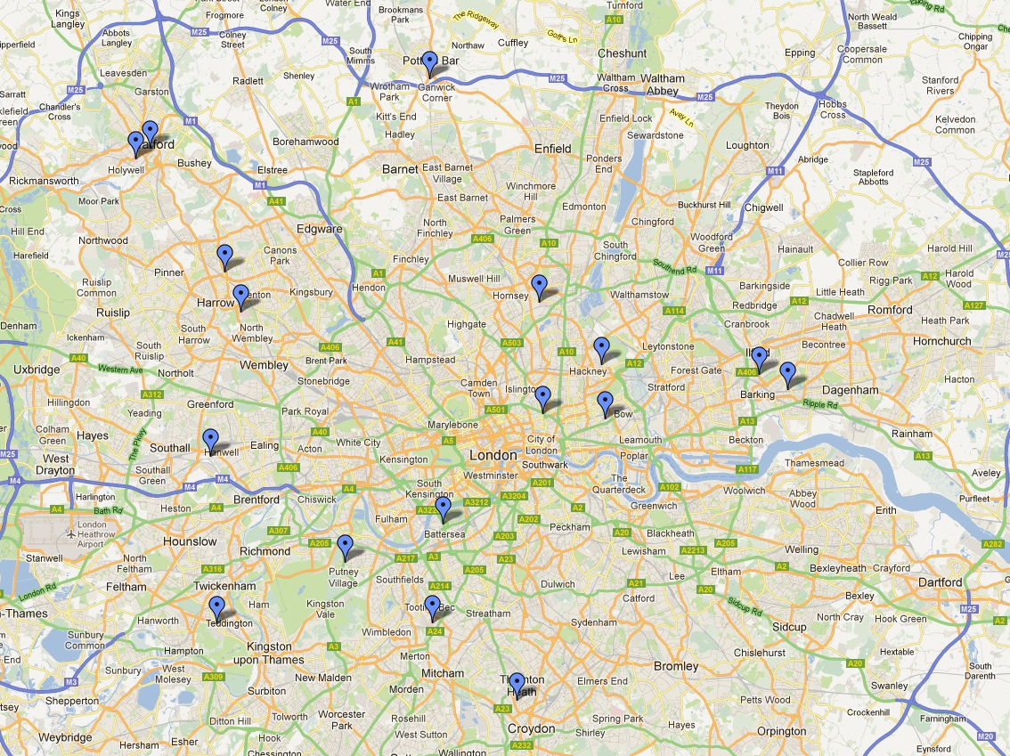
⬆
Princess Alexandra Harlow
⬆
⬆
Central Site
Bedford South
Bedford North
Potters
Bar
Watford Boots
District Hub
Watford Hospital
Local
Surgical Centre
Community outpatient
Visioncare,
Harrow
St Ann’s Tottenham
Joint Working
Northwick Park
Homerton Hospital
Sir Ludwig Guttman
Loxford Polyclinic
City Road
Mile End Hospital
Barking Hospital
Ealing
Bridge La Battersea
Queen Mary Roehampton
Darent Valley Hospital
Teddington Memorial
St George’s
Croydon
Purley Memorial

Slide 13
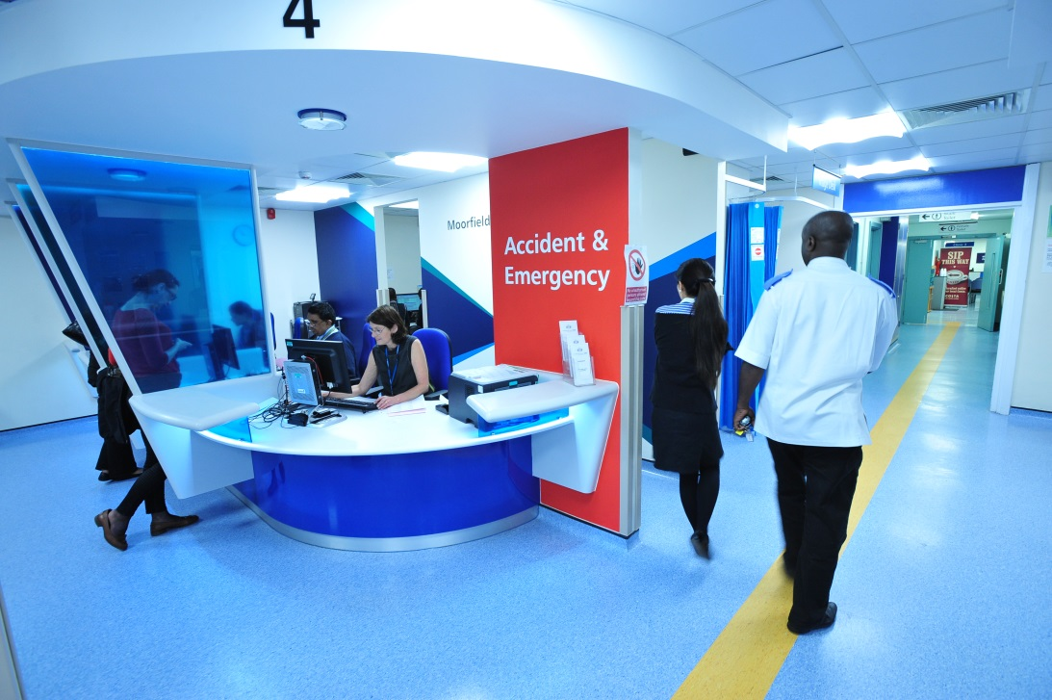
Growth

Slide 14
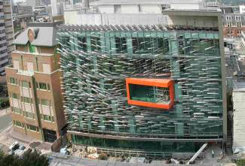
Translational research

Slide 15
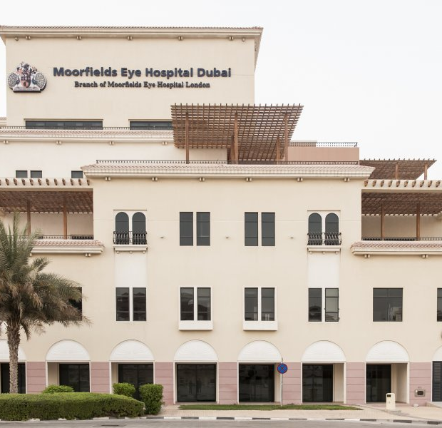
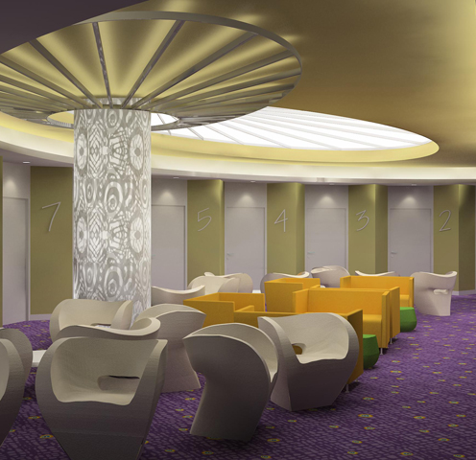
International

Slide 16
Where are we now?
Network:
Differentiated network – consistent quality
Local networks (chains within chains) – shifts from hospital settings / partnerships with primary care
Specialised work – continuing centralisation
Clinical Care:
Femto second phako trial
AMD / DMO / RVO… explosion in intravitreal injections
Translational research

Slide 17
Where might we be

Slide 18
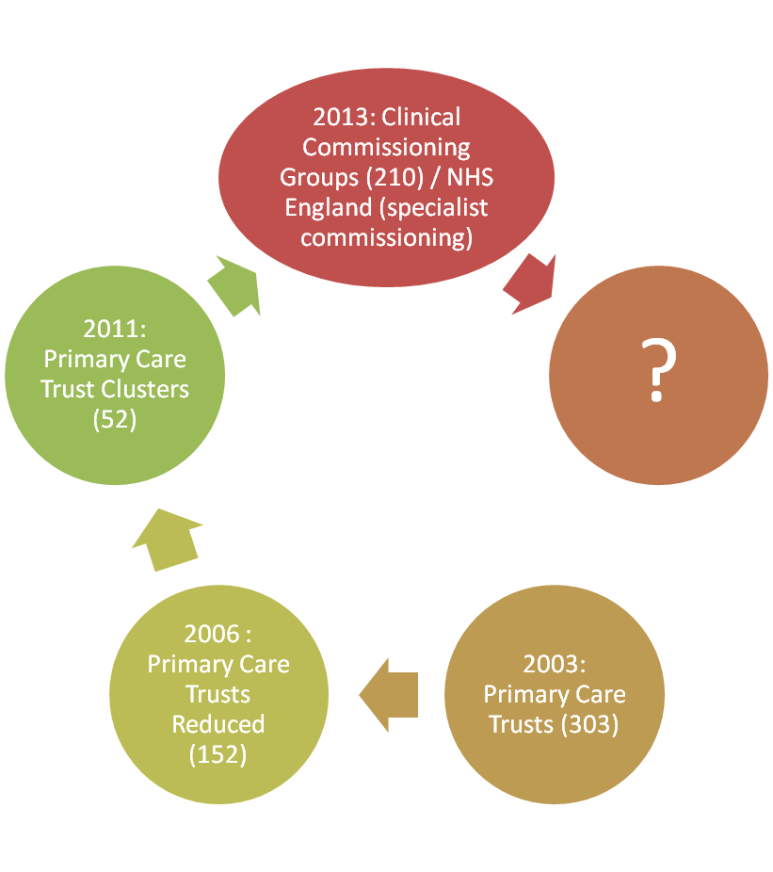
External Environment - Regulation
2013: NHS England specialist commissioning

Slide 19
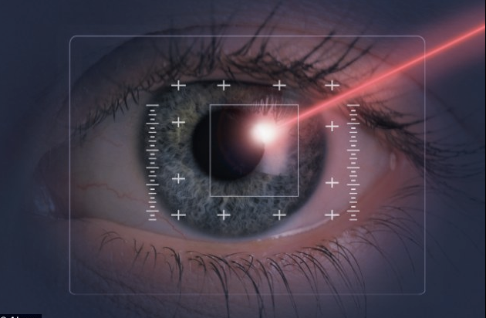
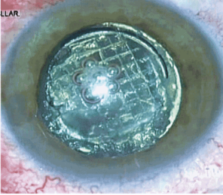
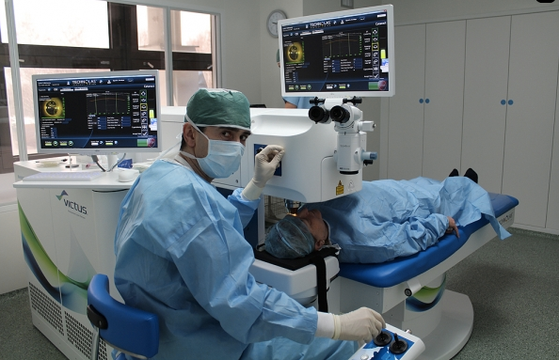
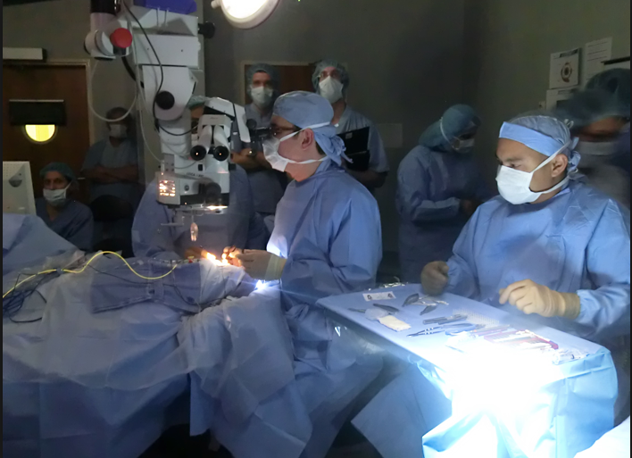
Technology

Slide 20
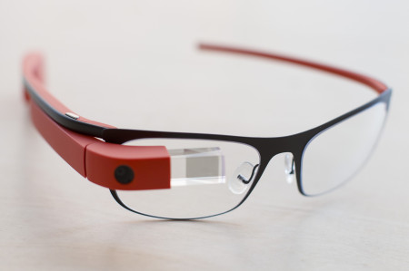
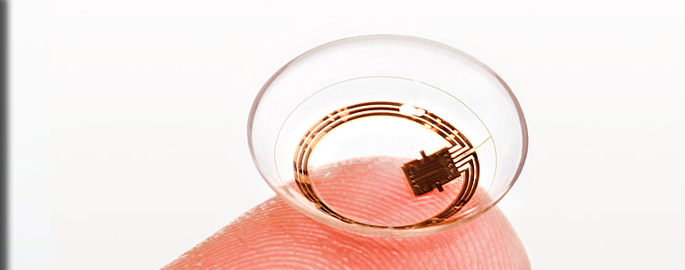
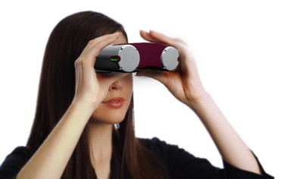
Technology

Slide 21
Gene & Stem Cell Therapy

Slide 22
Pathways

Slide 23
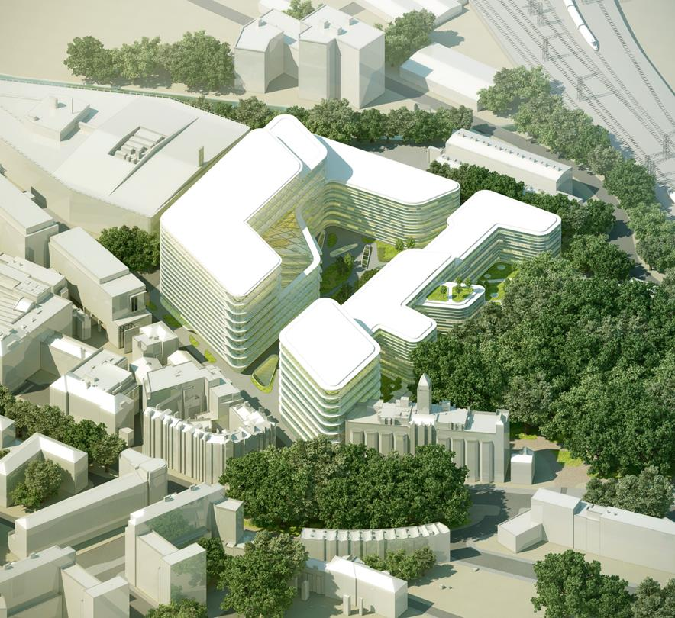
Integration

Slide 24
2030
Diagnosis – gene based predictive diagnosis validated by state of the art equipment in central locations
Surgery – technology-assisted cataract surgery (deskilling)
Treatment regimes – less invasive therapies, though not quite a pill to cure blindness
Long term conditions – managed by patients at home, remote monitoring
Research – integration to enable seamless transition from science to clinical care
Pathways – standardisation
Conclusion:
Care will be more dispersed with home care displacing “community” facilities
Hospital based care will become more centralised, hyper-specialisation
Standardisation will drive replicability and scale for “non-specialist” activity, the network will still be there

Slide 25
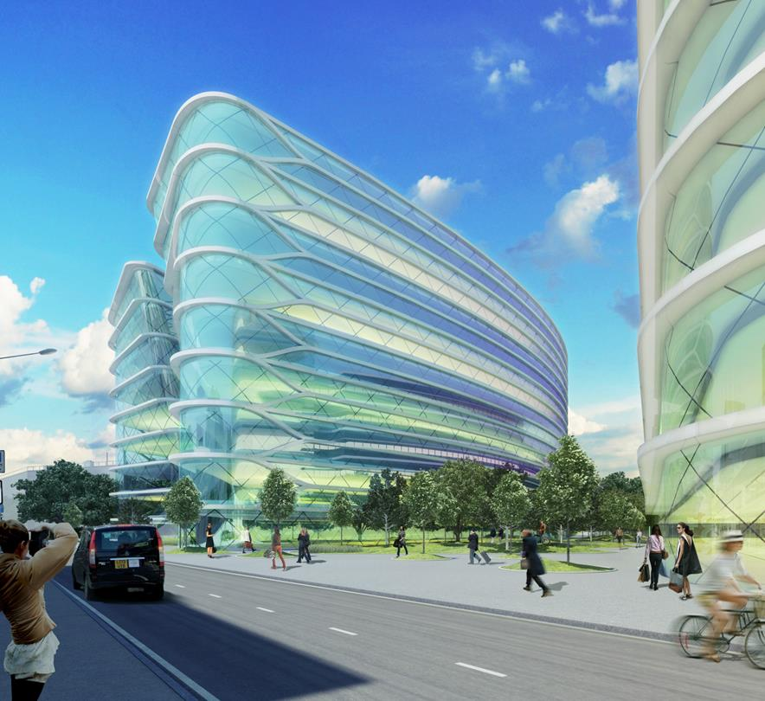
Dreaming of 2030

